Slide 1
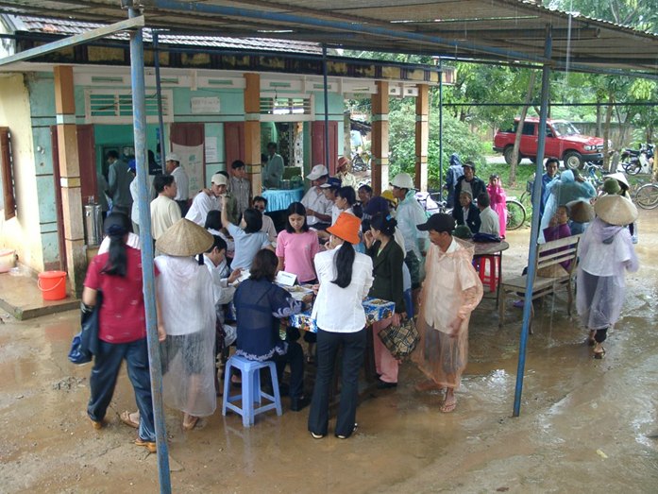
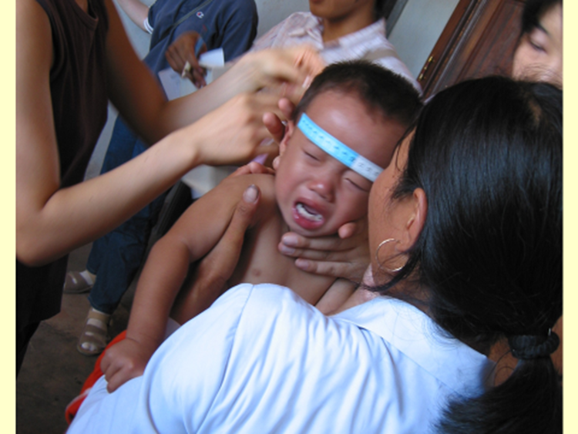
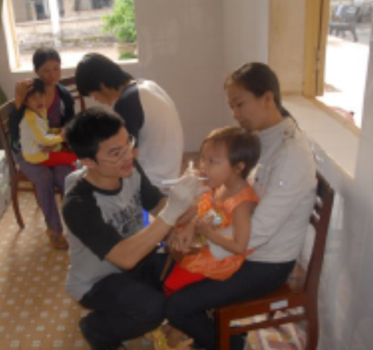
Project Title | The project on improvement of the growth retardation for the lower body weight infants at the severely polluted areas by herbicides/dioxins in Vietnam
Project Purpose | Maternal and child health activities are conducted autonomously and continuously, considering the effects by dioxins at Phu Cat Prefecture.
Duration | August, 2019～July, 2022；3years
Target Group | Infants (about 3,000), their mothers and families in Phu Cat Prefecture, in Binh Dinh Province
ＣＰ agency | Phu Cat District Health Center
Arrange the corresponding system | The lower body weight infants are specified. | Local medical staffs are cultivated. | Practice of nutritional guidance are conducted.
Kanazawa University shall cooperate with Phu Cat District Health Center and 3 cooperation agencies: 10-80 Division in Hanoi Medical University, Center for Environmental Monitoring for North Vietnam (NCEM), Vietnam National University, Hanoi | As results of health check-ups and examinations, low weight infants lactated by breast milk containing high dioxin concentration are specified. | Countermeasures based on the proper understanding of health hazards by herbicides are trained. | Based on the results of health check-ups, the practice of early ablactation and nutritional guidance are provided to mothers and their infants.

Slide 2
The project on improvement of the growth retardation for the lower body weight infants at the severely polluted areas by herbicides/dioxins in Vietnam
JICA Kanazawa Univ. Phu Cat District Health Center
(Local staffs are cultivated and practice are provided to target group.）
Vietnam National University, Hanoi
（hormone analysis）
NCEM
（dioxin analysis）
Hanoi Medical University （Medical support）
Japan Embassy: Grass-root support
（Incubator・Testing equipment）
Foundation
（dry milk/baby food）

Slide 3
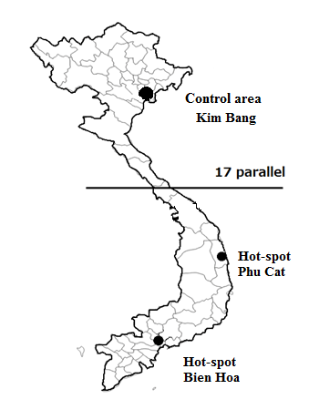
Hanoi
Target area
Map for action

Slide 4
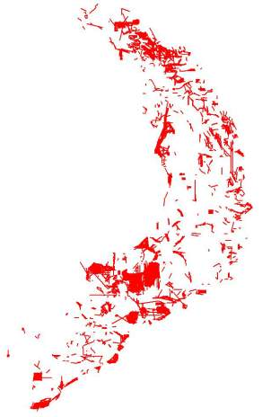
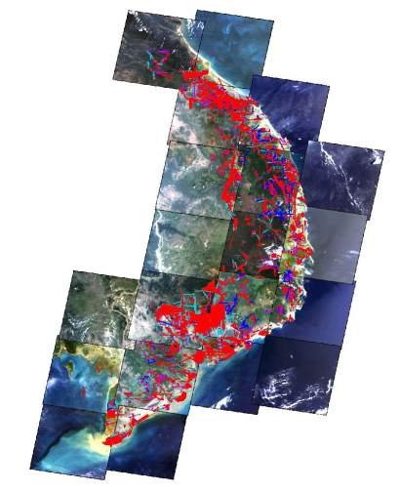
Dioxin and human health in Vietnam
Since 2002, annual health examinations have been conducted on inhabitants of the herbicide/dioxin sprayed areas and control areas in Vietnam.
Dioxin levels in human specimens such as serum, breast milk and adipose tissues were significantly higher in the sprayed areas than in the control areas.
Recently it was found at the first time in the world that human dioxin levels were related to sister chromatid exchange (SCE) or some steroid hormones.
1
Herbicide Map
2
Dioxin levels in breast milk
SLE and Dioxin
3
4
5
6
Notes:
① Since ２００２, annual health examinations have been ｃonducted on inhabitants of the herbicide/dioxin sprayed areas and control areas in Vietnam continuously until 2013.
② Using GPS system, we could confirm the herbicide sprayed area precisely.
③ Dioxin levels in human specimens such as serum, breast milk and adipose tissues were significantly higher in the sprayed areas than in the control areas.
④ It was found that human dioxin levels were related to sister chromatid exchange (SCE)
⑤ Especially, some steroid hormones were found to be effected by dioxin at the first time in the world and it was published in European Journal of Endocrinology in 2013.

Slide 5
Special Experiences related to Vietnam

